Slide 1
Utility and Its Concepts
E-Content for B.A Economics Honours
Semester -1
Paper –MJ1 Introductory Microeconomics
Unit 2- Consumer’s Behavior
Presented By
Aparna Pandey
Assistant Professor
Department of Economics
Yogoda satsanga Mahavidyalaya ,Ranchi

Slide 2
Meaning of Utility
• Utility refers to the satisfaction derived from consuming a good or service.
• It is subjective and varies from person to person.
• Example: A glass of water provides high utility to a thirsty person but little to one who is not thirsty.

Slide 3
Characteristics of Utility
1. Subjective in Nature
  Utility depends on individual preferences, tastes, and circumstances.
  The same good may provide high utility to one person and low (or no) utility to another.
2. Relative Concept
  Utility varies with time, place, and situation.
  Example: An umbrella has high utility on a rainy day but low utility on a sunny day.
3. Different from Usefulness
  A good may have utility even if it is not useful in a moral or social sense.
  Example: Cigarettes have utility for a smoker though they are harmful.
4.Independent of Morality
  Utility does not judge whether a good is good or bad—it is simply about satisfaction.
5. Measured Ordinally (Modern View)
  In modern economics, utility is measured in terms of preference ranking (1st, 2nd, 3rd choice), not in exact numbers.
6. Depends on Intensity of Want
  The stronger the desire for a good, the greater the utility derived from its consumption.

Slide 4
Measurement of Utility
Utility Theory
┌───────────────┴───────────────┐
│ │
Cardinal approach (Marshall) Ordinal approach (Hicks)
1.Cardinal Approach
- Utility can be measured in numbers (utils).
- Example: Apple = 10 utils, Banana = 5 utils.
2. Ordinal Approach
- Utility cannot be measured, only ranked.
- Example: Preference order – Tea > Coffee > Juice.

Slide 5
Types of Utility
1. Total Utility (TU)
Meaning: The overall satisfaction or happiness a consumer derives from consuming a given quantity of goods or services.
Example: If eating 1 apple gives you 10 units of satisfaction, and eating 2 apples gives 18 units, then the total utility of 2 apples is 18 units.
Formula:
TU=∑MU

Slide 6
2. Marginal Utility (MU)
Meaning: The additional satisfaction a consumer gains from consuming one more unit of a good or service.
Example: If TU from 1 apple = 10, and TU from 2 apples = 18, then
MU=TU2−TU1=18−10=8 So the second apple gives 8 units of utility.
Formula:
MUn=TUn−TUn−1

Slide 7
3. Average Utility (AU)
Meaning: The utility per unit of consumption, i.e., total utility divided by the number of units consumed.
Example: If TU from 4 apples = 32, then
AU=TU​/Q=32/4​=8
So on average, each apple gives 8 units of satisfaction.
Formula:
AU=TU/Q​

Slide 8
Total, Marginal, and Average Utility (Table)
Units Consumed(Roti) | Total Utility (TU) | Marginal Utility (MU)=TUn-TUn-1 | Average Utility (AU)= TU/Q
1 | 10 | 10 | 10
2 | 18 | 8 | 9
3 | 24 | 6 | 8
4 | 28 | 4 | 7
5 | 30 | 2 | 6
6 | 30 | 0 | 5
7 | 28 | -2 | 4
8 | 24 | -4 | 3

Slide 9
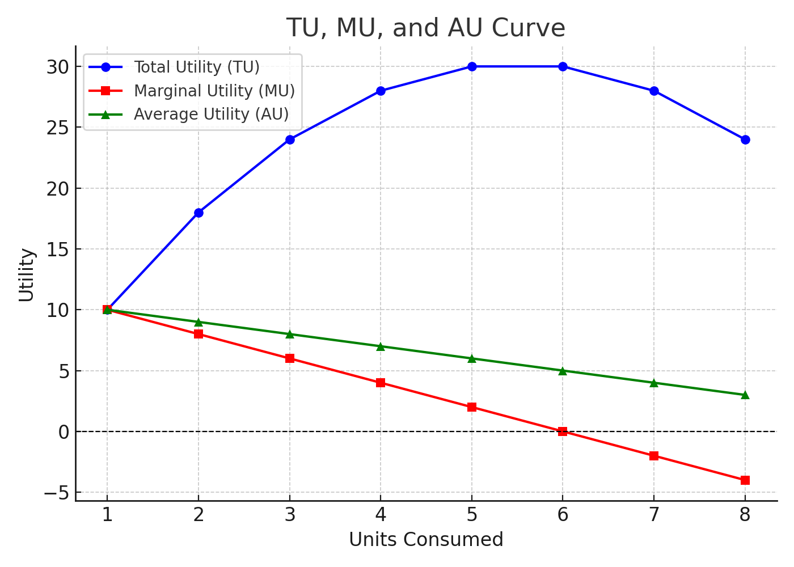
Graph: TU, MU, and AU

Slide 10
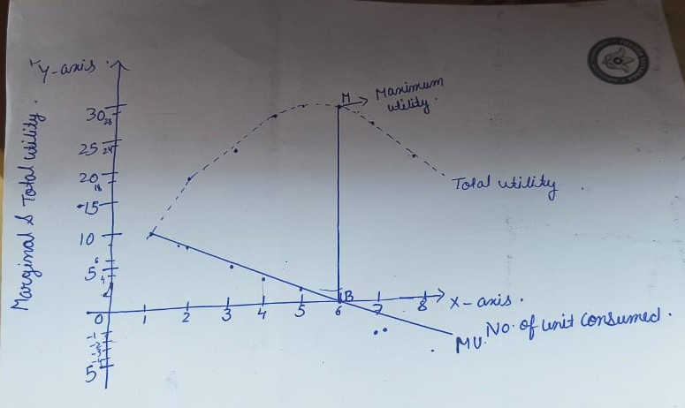
Relationship between Total utility and Marginal utility
1. Total utility increases as long as marginal utility is positive.
2.When marginal utility becomes zero, total utility is at maximum.
3.If marginal utility becomes negative, total utility starts to decline.

Slide 11
Law of Diminishing Marginal Utility
Definition
The Law of Diminishing Marginal Utility states:
As a person consumes more units of a good or service, the additional satisfaction (utility) gained from each extra unit tends to decrease, other things being constant. Also known as Gossen’s First Law.
Marshall stated:
“The additional benefit which a person derives from a small increase in the quantity of a good consumed diminishes with every increase in the quantity consumed, other things being equal.”
Marshall’s Example
Imagine a person drinking water:
  First glass: very refreshing → high MU.
  Second glass: less refreshing → lower MU.
  Third glass: hardly refreshing → very low MU.
  Fourth glass: might be unpleasant → negative MU

Slide 12
Assumptions of the Law of Diminishing Marginal Utility
1.Ceteris Paribus (Other Things Constant)
The law holds only if factors such as income, tastes, habits, and prices remain unchanged
Any change in these factors can affect the marginal utility of a good.
2.Rational Behavior of Consumers
Consumers are rational and aim to maximize total utility.
3.Goods Must Be Divisible
The good should be capable of being consumed in units.
4.Continuous Consumption
The consumption of additional units must be continuous and sequential, not in large jumps.

Slide 13
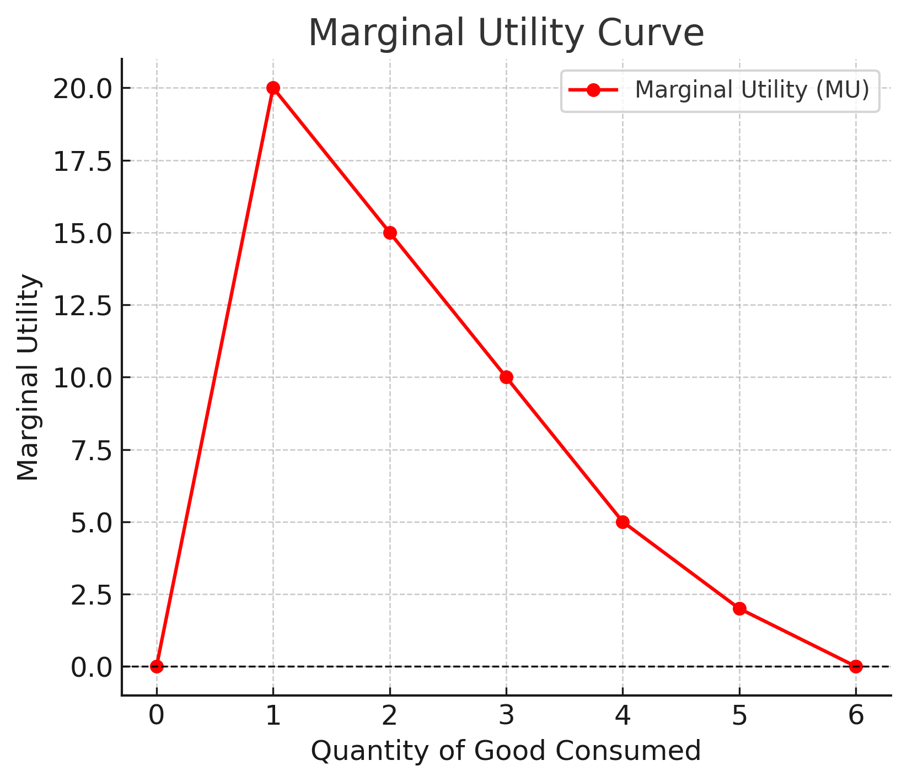
Law of Diminishing Marginal Utility

Slide 14
Law of Equi-Marginal Utility
Law of Maximum satisfaction
Law of Substitution
Gossen’s second law
The Law of Equi-Marginal Utility is a principle in economics that explains how consumers allocate their limited income among different goods and services to maximize total satisfaction (utility).
Definition:
The law states that a consumer reaches maximum satisfaction when the ratio of marginal utility (MU) of each good to its price (P) is equal for all goods purchased.
Mathematically:
MUx/Px= MUy/Py= MUz/Pz

Slide 15
Units Consumed | Marginal Utility of Chocolates (MUₓ) | Price of Chocolate (Pₓ = ₹10) | MUₓ / Pₓ | Marginal Utility of Juice (MUᵧ) | Price of Juice (Pᵧ = ₹20) | MUᵧ / Pᵧ
1 | 50 | 10 | 5.0 | 100 | 20 | 5.0
2 | 40 | 10 | 4.0 | 80 | 20 | 4.0
3 | 30 | 10 | 3.0 | 60 | 20 | 3.0
4 | 20 | 10 | 2.0 | 40 | 20 | 2.0
5 | 10 | 10 | 1.0 | 20 | 20 | 1.0

Slide 16
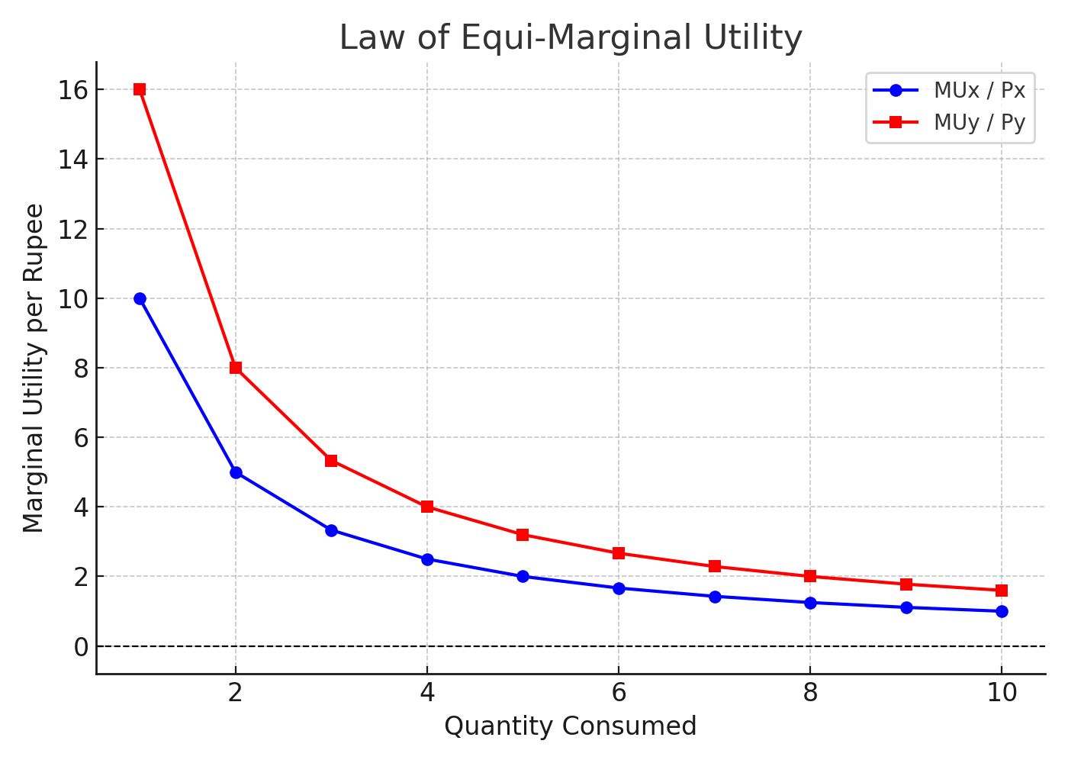
Law of Equi-Marginal Utility

Slide 17
The Equi-Marginal Point
A consumer will adjust their purchases until:
MUx / Px = MUy / Py
Looking at the graph, the two curves come close around quantities 5–6 units, where:
MUx/Px ≈ 2 MUy/Py ≈ 3 → 2.7 → 2.3
The trend indicates the balancing point where the consumer will stop shifting consumption between X and Y.
Interpretation
When MUy/Py > MUx/Px, the consumer buys more Y.
When MUx/Px > MUy/Py, the consumer buys more X.
The consumer reaches equilibrium when both MU per rupee values match.
This ensures maximum total utility from the limited budget.

Slide 18
Thank You

